Slide 1
AQI PREDICTION

Slide 2
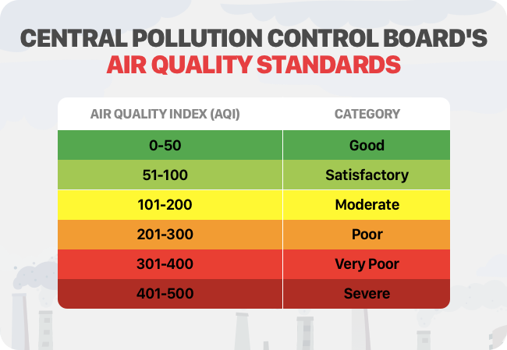
What is AQI?
Air Quality Index (AQI) is a scale used to report daily air quality, indicating how clean or polluted the air is and the associated health effects. It ranges from 0 to 500, with higher numbers indicating greater pollution and health concerns

Slide 3
Why AQI prediction is necessary?
AQI prediction is necessary to protect public health by providing early warnings about air pollution, allowing individuals to take precautions, and enabling policymakers to implement effective control strategies.
AQI (Air Quality Index) is typically calculated in real-time based on measured pollutant concentrations like PM2.5, PM10, NO2, SO2, CO, and O3. However, AQI prediction involves using historical data, meteorological factors, and sometimes machine learning models to estimate future AQI levels.

Slide 4
Project Timeline
Week | Phase | Key Activities
1 | Project Initiation & Planning | Define project scope, deliverables, and risks; Identify stakeholders; System Architecture Draft
2 | Research & System Design | Research existing models; Create System Architecture Diagram; Define Data Flow & Tech Stack
3 | Data Collection & Preprocessing | Collect AQI/weather data; Data Cleaning & Feature Engineering; Store in DB; EDA
4 | Data Collection & Preprocessing | Collect AQI/weather data; Data Cleaning & Feature Engineering; Store in DB; EDA
5 | Model Development & Training | Train ML & DL models (LSTM, XGBoost, RF); Hyperparameter tuning; Model evaluation
6 | Model Development & Training | Train ML & DL models (LSTM, XGBoost, RF); Hyperparameter tuning; Model evaluation
7 | Backend Development & API Creation | Develop REST API (Flask/FastAPI); Implement authentication, logging; Test API
8 | Frontend Development & Dashboard | Develop Web UI (React.js/Vue.js); Integrate Maps & Charts; Real-time AQI visualization
9 | Integration, Testing & Optimization | Connect frontend with API & DB; Perform unit & API testing; Optimize performance
10 | Integration, Testing & Optimization | Connect frontend with API & DB; Perform unit & API testing; Optimize performance
11 | Final Testing, Documentation & Handover | Conduct UAT Testing; Create Documentation & User Guide; Final Deployment
12 | Documentation & Presentation | Final Presentation of the Project

Slide 5
How to predict AQI?
Data Collection
Pollutants: PM2.5, PM10, NO₂, SO₂, CO, O₃
Meteorological: Temperature, Humidity, Wind Speed
Model Selection
Time Series Models: ARIMA, LSTM, GRU
Machine Learning: XGBoost, Random Forest, ANN
Training & Evaluation
Split data (Train/Test)
Use RMSE, MAE for evaluation
Tune hyperparameters

Slide 6
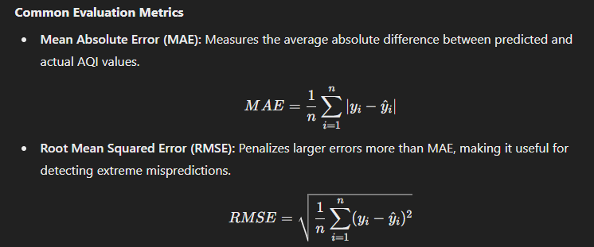
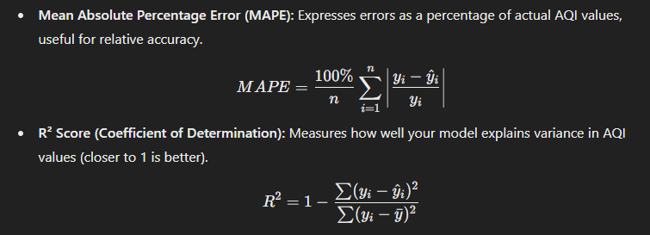
Model Evaluation

